Slide 1
Market fluctuations
ADMASTER-STAMP!MGR0330222101104
MGR0412243502436
MGR0330222101104
Notes:
Hi everyone, and thanks for finding the time to join us.
I’m [host name], and today, we’re going to talk about market fluctuations and what you can do in times of market volatility.
We’ll look at:
Tips for dealing with market volatility
Why the market goes up and down
What you need to know when investing in the markets and how to manage your risk
Strategies to help you decide what to do—or not do—to be informed and prepared

Slide 2
Market volatility can be unsettling
ADMASTER-STAMP!MGR0330222101104
MGR0412243502436
Notes:
Markets will rise and fall, but over time, markets have always moved higher. We’ve seen this happen as recently as the past three years. You may recall that the markets took a dip at the onset of the pandemic but quickly recovered—and in some cases rose higher—by the pandemic’s end.
When markets fall, you may be asking yourself:
How sharp will this downturn be?
How long will it last?
Will this market downturn be more severe than what we’ve experienced in the past?
We know a market downturn is unsettling but, in times like these, the most important message is to focus on what you can control and stay disciplined with your strategy.
For many of you, investing for retirement may be a long-term commitment, and while everyone has a view on which direction the markets will go, no one can predict what will happen next. All anyone can do is try to manage risk.

Slide 3
Tips for dealing with market volatility
ADMASTER-STAMP!MGR0330222101104
Do
Stay committed to your plan
Take a long-term perspective
Turn market volatility into an advantage
Continue your regular contributions
Talk to a licensed financial professional
Don’t
Try to time the market
Panic
MGR0412243502436
Notes:
Investing during volatile times can challenge your discipline and commitment to your investment strategy.
Here are some principles to help ease your mind:
First, review your goals and stay disciplined and committed to your investment plan. If your goals and timeframe haven’t changed, your investment strategy shouldn’t either.
Don’t jump ship or try to time the market. If you do this, you’ll most likely end up selling at a lower price and buying at a higher price later when you reinvest. The difference between investment success and disappointment can boil down to a few days of being in or out of the markets.
Take a long-term perspective. As I’ve already said, markets will rise and fall but, over time, markets have always moved higher.
Turn market volatility into your advantage. By investing a specific amount at regular intervals, dollar cost averaging can help you buy more units of an investment at lower prices and fewer at higher prices. This helps take the worry out of making a single lump-sum investment at the wrong time. If you’re putting money into your plan every paycheck or every month, keep doing that to take advantage of lower prices.
Finally, at times like these, you may feel an impulse, large or small, to push the panic button. But panicking often leads to wrong decisions and may hurt you in the long run. Talk to a licensed financial professional. Financial professionals can help you determine how to weather the turbulence—it’s what they do.

Slide 4
What is risk?
ADMASTER-STAMP!MGR0330222101104
MGR0412243502436
Notes:
How do we define risk when we think about investing in the stock market?​
Broadly speaking, risk is the possibility of losing something we value. We can think about our physical health, our emotional well-being, or something that could happen to our family members or our property. ​
In the practical world of investments, we can see risk as the possibility that the money we expect to be there when we need it will be missing in part or, worse, won’t be there at all. ​
There are several standard market risk factors, including:​
Equity risk—The risk that share prices will change​
Commodity risk—The likelihood that a commodity price, such as that of a metal (gold) or grain, will change
Currency risk—The probability that foreign exchange rates will change
Interest-rate risk—The risk that interest rates will go up or down
Inflation risk—The risk that overall rises in prices of goods and services will undermine the value of money and probably adversely affect the value of investments
Unexpected events—The pandemic is an example

Slide 5
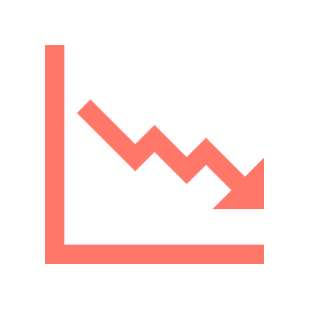
What moves the stock market up and down?
ADMASTER-STAMP!MGR0330222101104
Company profits
Interest rates
Consumer confidence
Economic outlook
Political climate
Unforeseen events such as the pandemic
Past performance does not guarantee future results.
MGR0412243502436
Notes:
The stock market can be quite complex, and there are many factors that move the stock markets every day. ​
First, in any stock market move, whether up or down, there’s a significant difference between supply and demand. Simply put, supply is the number of shares people want to sell and demand is the number of shares people are looking to buy. After all, the stock market itself is just a collection of individual companies. If more people want to buy a stock (demand) than sell it (supply), then the price moves up; conversely, if more people wanted to sell a stock than buy it, there would be greater supply than demand, and the price would fall.
Other factors that determine whether stock prices rise or fall include the media, company profits, consumer confidence, natural disasters, political and social unrest, and unforeseen events such as the pandemic, inflation, and risk. The collection of these factors, plus all relevant information that’s been published, creates a certain type of sentiment. The sentiment may be bullish, meaning positive, or bearish, meaning negative.
If we look back at what the happened during the pandemic, a lot of the market activity was driven by the potential impact of COVID-19 on company profits, consumer confidence, and spending.

Slide 6
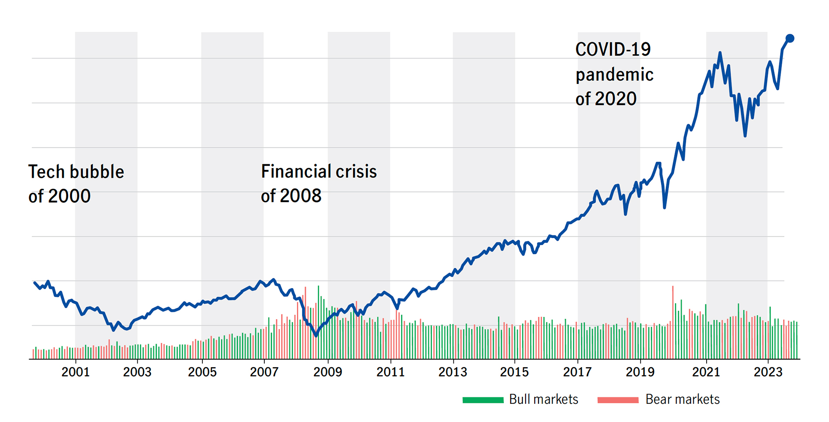
Understanding the ups and downs of the market
ADMASTER-STAMP!MGR0330222101104
All rights reserved. Verizon, in partnership with ChartIQ and Yahoo! Finance. This hypothetical example is for illustrative purposes only. S&P 500 Index at close on 1/31/24. Indexes are unmanaged and cannot be invested in directly.
MGR0412243502436
Notes:
Over longer periods—usually, 10 years or more—markets have consistently realized growth. Within those periods, however, there have been both bear markets, which refers to a declining market) and bull (or growing) markets.
Let’s take a look at this chart of the S&P 500 Index so you can understand how the stock market has behaved over a long period of time.
We’ve seen a trend where, every few years, there’s a correction in the market, and prices drop. This is what happened when the pandemic hit in early 2020. Then markets recover. Over a long period of time, markets trend upward; however, we saw this recovery happen rather quickly in the latter part of 2020 and in first half of 2021, where markets reached record highs in many sectors. Keep in mind, when looking at the stock market, that past performance and trends don’t guarantee how funds will perform in the future. ​
Even so, historically, stocks have offered good opportunities for growth. Over longer periods—usually 10 years or more—markets have consistently realized growth, although there have been periods of strength and of decline during those cycles. ​​

Slide 7
Tested investment strategies
ADMASTER-STAMP!MGR0330222101104
Diversify your investments
Regularly contribute
Balance risk and reward
Keep emotions out of investments
There is no guarantee that any investment strategy will achieve its objectives.
Diversification does not guarantee a profit or eliminate the risk of a loss.
MGR0412243502436
Notes:
Diversify your investments
One of the first strategies to help reduce risk is diversification. ​
Diversification isn’t just for choosing individual stocks. It also means that you should consider looking at different types of investments that are within your retirement accounts, also known as a portfolio. ​
For example, you may want to consider including investments like those in the stock markets but from different regions of the world: the Canadian stock market, the U.S. stock market, and even the international stock markets. ​
You also may want to consider including some investments that are less volatile such as fixed income, which are your bond funds or guaranteed investments.
Again, some fund managers have prepackaged solutions for investors—meaning in one single diversified fund—to help them achieve their objectives while controlling their risk.​

Slide 8
Tested investment strategies
ADMASTER-STAMP!MGR0330222101104
Diversify your investments
Contribute regularly
Balance risk and reward
Keep emotions out of investments
Dollar cost averaging does not guarantee a profit or eliminate the risk of a loss. Systematic investing involves continuous investment in securities regardless of price level fluctuation. Participants should consider their resources to continue the strategy over the long term.
MGR0412243502436
Notes:
Contribute regularly
Contributing regularly is an excellent investment strategy that may help you benefit from market fluctuations. How, you may ask?​
Each time you contribute to your retirement plan, your contributions buy units of your chosen investment options. When the market goes up, the value of your holdings increases, and you buy units at a higher price. When the market goes down, you buy more units at a lower price.​​ ​Over time, this technique—known as dollar cost averaging—can lower the average price you pay per unit.

Slide 9
Tested investment strategies
ADMASTER-STAMP!MGR0330222101104
Diversify your investments
Contribute regularly
Balance risk and reward
Keep emotions out of investments
Your quiz results may change over time. We encourage you to take the risk quiz periodically to ensure that your risk profile accurately matches your risk tolerance.
Results are based on generally accepted investment principles, but by no means are you bound by the results, nor should you consider the results investment advice. There is no guarantee that any particular asset allocation or mix of funds will meet your investment objectives. Investing involves risks, and fluctuations in the financial markets and other factors may cause declines in the value of your account.
MGR0412243502436
Notes:
Balance risk and reward
As we covered earlier, lots of things may influence the performance of your investments, and it can be very hard to know where the direction of the stock market is going.​
The first thing to ask yourself is how likely is it that you’ll need access to this money in the short term? ​
If the answer is very likely, then it’s generally best to avoid unnecessary risk with your investments. You may want to choose investments that are more likely to have a predictable outcome. ​
If the answer is that it’s very unlikely that you’ll need this money in the short term, the second thing you need to ask yourself is how far in the future do you want to access this money? Generally, the longer your investment horizon, the more volatility you can live with in the short term.​
If you’re not sure about your risk tolerance, I encourage you to complete a risk questionnaire. Once you know your risk profile, it’s important to review it periodically.​
The shorter your investment horizon, the more closely you should review your investments and ask yourself these same questions. ​

Slide 10
Tested investment strategies
ADMASTER-STAMP!MGR0330222101104
Diversify your investments
Contribute regularly
Balance risk and reward
Keep emotions out of investments
There is no guarantee that any investment strategy will achieve its objectives.
MGR0412243502436
Notes:
Keep emotions​ out of investments
Finally, it's important to keep your emotions in check.​
Markets get volatile, and your investments may drop in value. It’s natural to feel a little nervous, but don’t let your nerves cause you to take action. Changes in the market are short term, and your retirement savings is invested for the long term.
If you move your money to safer investments during a market downturn, you miss out on the opportunity to take advantage of the market recovery.
Be aware of what’s happening in the market, but stay focused on your goal. Unless your retirement is imminent, you’re likely better off staying the course until the market corrects itself.

Slide 11
Final thoughts
ADMASTER-STAMP!MGR0330222101104
w
Do
Stay committed to your plan
Take a long-term perspective
Turn market volatility into an advantage
Continue your regular contributions
Talk to a licensed financial professional
Don’t
Try to time the market
Panic
There is no guarantee that any investment strategy will achieve its objectives.
MGR0412243502436
Notes:
As we reach the end of our discussion today, here are a couple of things to keep in mind when you’re investing in the market:
First, review your goals and stay disciplined and committed to your investment plan. If your goals and timeframe haven’t changed, your investment strategy shouldn’t either.
Take a long-term perspective. Markets will rise and fall but, over time, markets have always moved higher. In the past, markets have recovered within a year or two of a correction.
Turn market volatility into your advantage by continuing your regular contributions.
Don’t try to time the market.
Above all, don’t panic. A licensed financial professional can help you with your specific situation.

Slide 12
Thank you!
ADMASTER-STAMP!MGR0121211482763
Information in this presentation is for educational purposes and not intended to constitute expert advice on any particular matter.
MGR0412243502436
Notes:
Thank you for attending this session.

Slide 13
Important information
ADMASTER-STAMP!MGR0330222101104
For complete information about a particular investment option, please read the fund prospectus. You should carefully consider the objectives, risks, charges, and expenses before investing. The prospectus contains this and other important information about the investment option and investment company. Please read the prospectus carefully before you invest or send money. Prospectuses may only be available in English.
It is your responsibility to select and monitor your investment options to meet your retirement objectives. You should review your investment strategy at least annually. You may also want to consult your own independent investment or tax advisor or legal counsel.
The content of this document is for general information only and is believed to be accurate and reliable as of the posting date, but may be subject to change. It is not intended to provide investment, tax, plan design, or legal advice (unless otherwise indicated). Please consult your own independent advisor as to any investment, tax, or legal statements made.
John Hancock Retirement Plan Services LLC, 200 Berkeley Street, Boston, MA 02116
NOT FDIC INSURED. MAY LOSE VALUE. NOT BANK GUARANTEED.
© 2024 John Hancock. All rights reserved.
MGS-P41878 GE 04/24 444545 MGR0412243502436
MGR0412243502436

Slide 14
ADMASTER-STAMP!MGR0330222101104
MGR0412243502436

